Slide 1

Azure Machine Learning & Cortana Intelligence Suite
Amy Nicholson – Technical Evangelist
@AmyKateNicho
Notes:
Machine Learning – often a key concept when talking about advanced analytics and intelligence, lets deep dive into what machine learning is, where it is being used today and how Microsoft is enabling democratisation of machine learning
So some examples
Bing predicts the Premier League football scores on a weekly basis given statistics from the past performances, environmental data etc. As well as various political elections and award shows like the oscars
Thyseen Krupp a lift company in the US are trying to predict when lifts will break down. Are they able to look at the sensor readings, the service data, the parts, make and model and try and predict or pre-empt when a lift will break down
An example I often use as a demo, can we predict if a flight will be delayed or not given the flight and weather details
All these predictions involve some form, some complex some simple, of machine learning algorithm. So lets take a look at machine learning

Slide 2
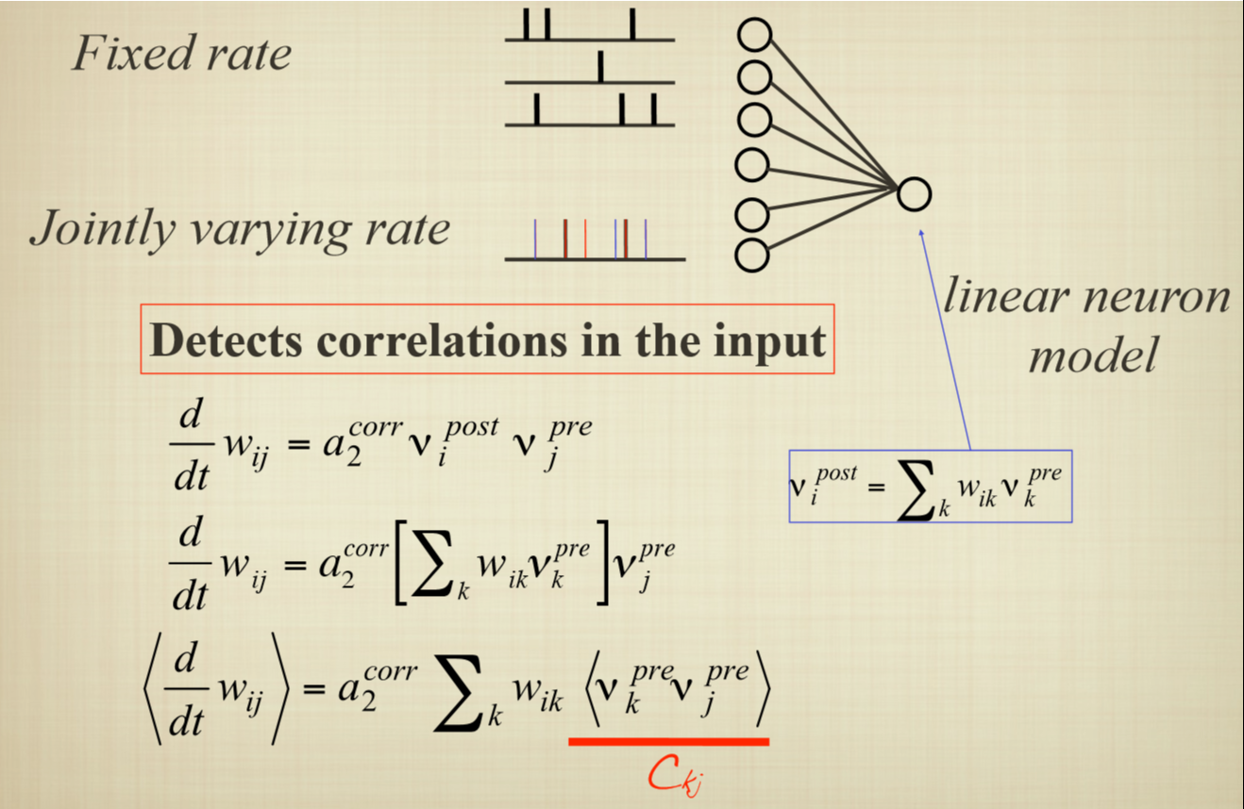
Notes:
So this is how I was introduced to machine learning in academia, this is an algorithm called adaptive intelligence a form a reinforcement learning
OK so looking around I am seeing some worried looking faces – did she get the right brief, are we in the right room.
I wanted to show my experience from only a few years ago and contrast it with

Slide 3
Computing Systems that become smarter with Experience Experience = Past Data + Human Input
@AmyKateNicho
Notes:
This. Microsoft is enabling the democratisation of machine learning by creating tools and pre-built solutions .
So I want to talk to you about machine learning like this
Where machine learning is computer systems that become smarter with experience
This is the only equation we will see today – past data + human input
Where past data is growing on a daily basis, we have data coming from …
And where often the human input describes the type of machine learning used
Given past data can we try to predict what might happen in the future

Slide 4

Notes:
Click stream prediction models – showing the efficiency of Learning by Counts options for large sparse data sets.
Classification – two class, will the customer click the advert or not (1 or 0)
http://blogs.technet.com/b/machinelearning/archive/2015/11/03/using-azure-ml-to-build-clickthrough-prediction-models.aspx

Slide 5

Notes:
Anomaly Detection – credit card fraud, being able to spot that anomaly point in your data, being able to alert in real time if something doesn’t look quite right

Slide 6

Notes:
Clustering – customer/audience segmentation
Recommendation engines and the ability to build into Azure ML

Slide 7




Why Now?
@AmyKateNicho
Notes:
So why now?
In the past many algorithms quite old, however had to be simplified to actually be usable, now this is no longer a problem and complex algorithms can be used. This is because of 3 factors
One, we can use the power of the cloud and borrow the compute power and storage from there
Agility/ease of use – rapidly prototyping, Being able to train these models in a shorter amount of time
And the easily available data to sufficiently train these models. Connected devices
This has allowed for machine learning to be operationalized and available to everyone to produce intelligent applications

Slide 8
What is Azure Machine Learning
Data
Clients
API
ML STUDIO
Model is now a web service that is callable
Blobs and Tables
Hadoop (HDInsight)
Relational DB (Azure SQL DB)
Integrated development environment for Machine Learning
Monetize the API through our marketplace
Notes:
The elegance of the solution is in its simplicity – something that has been lacking in the machine learning space
The first issue many enterprises face is data ingestion. With the cloud, you can bring in data sources with the ease of a drop down or drop your on-premises data set into the built in storage space. Users can then model in our development environment – Machine Learning Studio
where we’re offering R, Python and SQLite as first class citizens in addition to our world-class Microsoft algorithms.
The second issue – and often the primary one – is putting finished work into production in a way others can use. Client devices, websites, mobile applications, excel spreadsheets you name it anything that supports HTTP requests.
We’ve heard from many data scientists that they model in R on a Linux stack but then have to hand over their work to developers who need to translate that into another language to actually make it work.
This time consuming and unnecessary process has been eliminated with our system, as the model is with a click transformed into a web service end-point that can run over any data, anywhere and connect to any solution or client.
Next, not only can this model be put into production for your company, it can be made available for the world on our Machine Learning Marketplace. Microsoft hosts your solution and markets it for you, while you have the freedom to brand and monetize as you see fit.

Slide 9
Azure Machine Learning Studio https://studio.azureml.net/
@AmyKateNicho
Notes:
Work through and build out an experiment in Azure ML from scratch
Bring in data, data pre-processing modules
Split
Train score evaluate
Compare models

Slide 10
Machine learning is just one jigsaw piece
But …
@AmyKateNicho

Slide 11






Twitter Sentiment Orb: Architecture
@AmyKateNicho
Notes:
Twitter Data sent to the Text Analytics Machine Learning API and scored (positive/negative sentiment)
Raw tweet data + prediction is sent to Event Hubs – A large data ingestion service in Azure.
Now we have every single tweet with a specified hashtag or keyword being sent to Azure so we want to average the current sentiment of the large amount of data. We use Stream Analytics to write T-SQL queries that averages the sentiment over the last 10 sec (can change the window space) and output this to another Event Hub.
The output event hub is sending the averaged sentiment values to a website which shows a glowing orb.
The orb changes colour depending on the sentiment – negative (red), neutral (yellow), positive (green) and all the subtle variations in between.

Slide 12
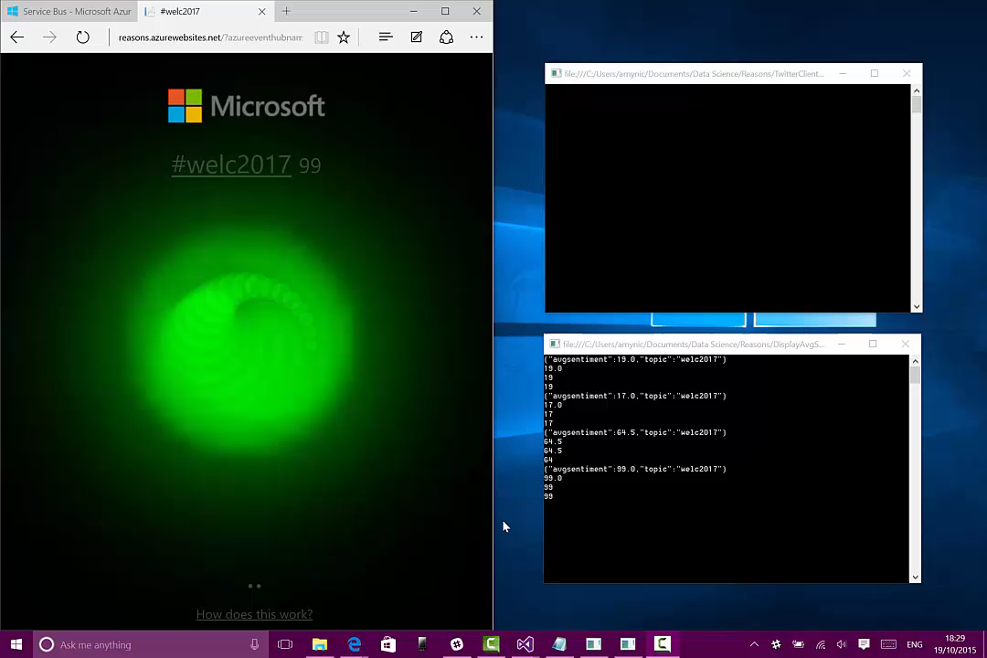
Notes:
A video to show the sentiment orb in action
Sending different tweets to the #welc2017 – both positive and negative to see the orb change colour every 10 secs
Top command line console – a tweet sent with specified hashtag and the sentiment value acquired from the ML API
Bottom command line console – the output event hub details in real time showing the average sentiment at that point in time
Then the website will refresh to show the average sentiment value next to the hashtag and the orb changes colour
The idea around streaming data and machine learning paired together being extremely powerful. Also the visualisation aspect of the story – an orb changing colour showing an immediate understanding of the averaged data – not a large table of values a point in time visual.

Slide 13
Cortana Intelligence: Data to Intelligent Action
Information Management
Big Data Stores
Machine Learning and Analytics
Intelligence
Data Sources
People
Data Factory
Data Lake Store
Machine Learning
Cognitive Services
Data Catalog
SQL Data
Warehouse
Data Lake Analytics
Bot Framework
Web
Apps
HDInsight
(Hadoop and Spark)
Event Hubs
Cortana
Mobile
Apps
Stream Analytics
Bots
Dashboards & Visualizations
Sensors and devices
Power BI
Automated Systems
Data
Intelligence
Action
Notes:
Cortana Intelligence delivers an end-to-end platform with an integrated and comprehensive set of tools and services to help you build intelligent applications that let you easily take advantage of Advanced Analytics and intelligence capabilities.
First, Cortana Intelligence provides services to bring data in, so that you can analyze it. It provides information management capabilities like Azure Data Factory so that you can pull data from any source (relational DB like SQL or non-relational ones like your Hadoop cluster) in an automated and scheduled way, while performing the necessary data transforms (like setting certain data columns as dates vs. currency etc). Think ETL (Extract, Transform, Load) in the cloud. Event Hubs does the same for IoT type ingestion of data that streams in from lots of end points.
The data brought in then can be persisted in flexible big data storage services like Data Lake Store and Azure SQL Data Warehouse.
You can then use a wide range of analytics services from Machine Learning to Azure Data Lake Analytics to Azure HDInsight to Azure Stream Analytics to analyze the data stored in the big data storage. This means you can create analytics services and models specific to your business need (say real time demand forecasting).
The resultant analytics services and models created by taking these steps can then be surfaced as interactive dashboards and visualizations via Power BI.
These same analytics services and models created can also be integrated into various different UI (web apps or mobile apps or rich client apps), or with Cortana, so end users can naturally interact with them via speech etc., and so that end users can get proactively be notified by Cortana if the analytics model finds a new anomaly (unusual growth in certain product purchases- in the case of real time demand forecasting example given above) or whatever deserves the attention of the business users. Similar integration can occur with Cognitive Services or Bot Framework based applications.
At a high level though, Cortana Intelligence capabilities are in three main areas: data, analytics and intelligence.

Slide 14
Cortana Intelligence: Data to Intelligent Action
Information Management
Big Data Stores
Machine Learning and Analytics
Intelligence
Data Sources
People
Data Factory
Data Lake Store
Machine Learning
Cognitive Services
Data Catalog
SQL Data
Warehouse
Data Lake Analytics
Bot Framework
Web
Apps
HDInsight
(Hadoop and Spark)
Event Hubs
Cortana
Mobile
Apps
Stream Analytics
Bots
Dashboards & Visualizations
Sensors and devices
Power BI
Automated Systems
Data
Intelligence
Action
Notes:
Cortana Intelligence delivers an end-to-end platform with an integrated and comprehensive set of tools and services to help you build intelligent applications that let you easily take advantage of Advanced Analytics and intelligence capabilities.
First, Cortana Intelligence provides services to bring data in, so that you can analyze it. It provides information management capabilities like Azure Data Factory so that you can pull data from any source (relational DB like SQL or non-relational ones like your Hadoop cluster) in an automated and scheduled way, while performing the necessary data transforms (like setting certain data columns as dates vs. currency etc). Think ETL (Extract, Transform, Load) in the cloud. Event Hubs does the same for IoT type ingestion of data that streams in from lots of end points.
The data brought in then can be persisted in flexible big data storage services like Data Lake Store and Azure SQL Data Warehouse.
You can then use a wide range of analytics services from Machine Learning to Azure Data Lake Analytics to Azure HDInsight to Azure Stream Analytics to analyze the data stored in the big data storage. This means you can create analytics services and models specific to your business need (say real time demand forecasting).
The resultant analytics services and models created by taking these steps can then be surfaced as interactive dashboards and visualizations via Power BI.
These same analytics services and models created can also be integrated into various different UI (web apps or mobile apps or rich client apps), or with Cortana, so end users can naturally interact with them via speech etc., and so that end users can get proactively be notified by Cortana if the analytics model finds a new anomaly (unusual growth in certain product purchases- in the case of real time demand forecasting example given above) or whatever deserves the attention of the business users. Similar integration can occur with Cognitive Services or Bot Framework based applications.
At a high level though, Cortana Intelligence capabilities are in three main areas: data, analytics and intelligence.

Slide 15
Key Takeaways
Check out the Machine Learning blog for details on more of Azure ML’s features and stories: http://blogs.technet.com/b/machinelearning/
Investigate the Cortana Intelligence Gallery for examples of models and notebooks
https://gallery.cortanaintelligence.com/
We have only scratched the surface of the service available in Cortana Intelligence Suite: https://www.microsoft.com/en-gb/cloud-platform/what-is-cortana-intelligence-suite
Amy Nicholson - Technical Evangelist
amynic@microsoft.com

